Slide 1

Introduction to ML strategy
Why ML
Strategy?
deeplearning.ai

Slide 2
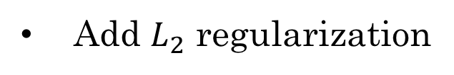

Motivating example
Ideas:
Collect more data
Try dropout
Collect more diverse training set
Add $L_{2}$ regularization
Train algorithm longer with gradient descent
Network architecture
Try Adam instead of gradient descent
Activation functions
Try bigger network
# hidden units
Try smaller network
…

Slide 3
Introduction to ML strategy
Orthogonalization
正交化
deeplearning.ai

Slide 4
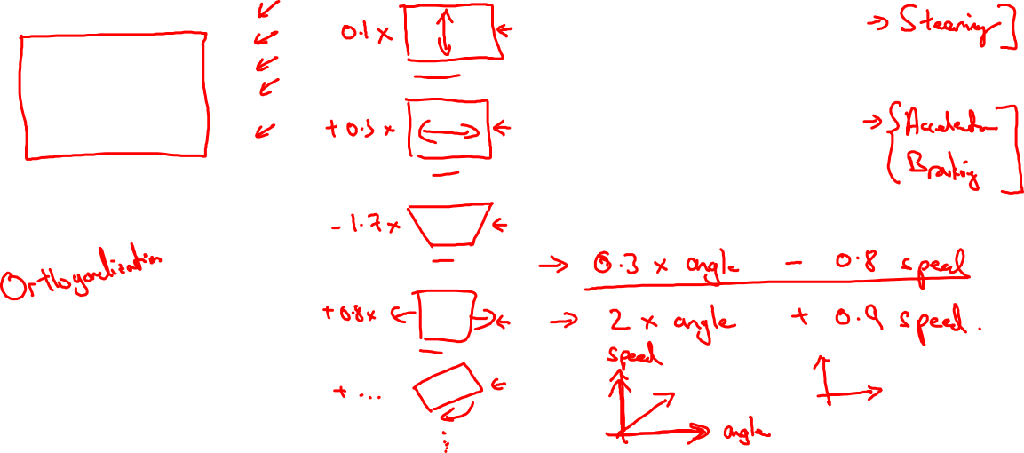
TV tuning example
Car

Slide 5
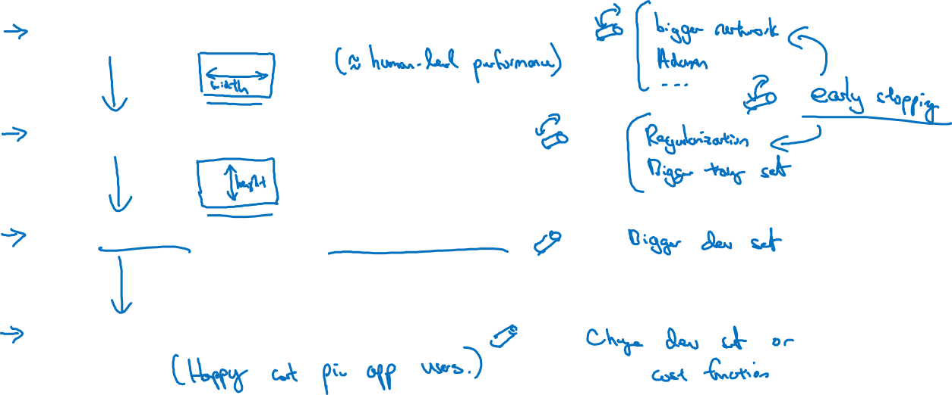
Chain of assumptions in ML
Fit training set well on cost function
Fit dev set well on cost function
Fit test set well on cost function
Performs well in real world

Slide 6
Orthogonalization(Supplemental Notes)
Orthogonalization or orthogonality is a system design property that assures that modifying an instruction or a component of an algorithm will not create or propagate side effects to other components of the system. It becomes easier to verify the algorithms independently from one another, it reduces testing and development time.
When a supervised learning system is design, these are the 4 assumptions that needs to be true and orthogonal.
1. Fit training set well in cost function
- If it doesn’t fit well, the use of a bigger neural network or switching to a better optimization algorithm might help.
2. Fit development set well on cost function
- If it doesn’t fit well, regularization or using bigger training set might help.
3. Fit test set well on cost function
- If it doesn’t fit well, the use of a bigger development set might help
4. Performs well in real world
- If it doesn’t perform well, the development test set is not set correctly or the cost function is not evaluating the right thing.

Slide 7
Setting up your goal
Single number
evaluation metric
deeplearning.ai

Slide 8

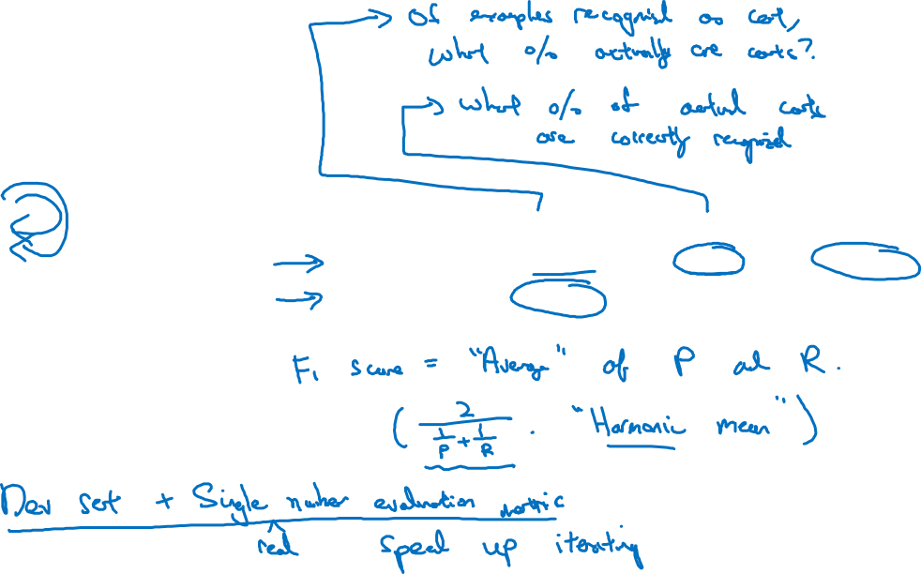
Using a single number evaluation metric
Idea
Classifier | Precision | Recall | F1 Score
A | 95% | 90% | 92.4%
B | 98% | 85% | 91.0%
Experiment
Code

Slide 9
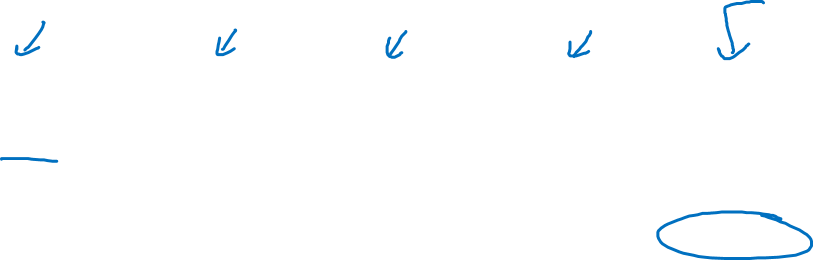
Another example
Algorithm | US | China | India | Other | Average
A | 3% | 7% | 5% | 9% | 6%
B | 5% | 6% | 5% | 10% | 6.5%
C | 2% | 3% | 4% | 5% | 3.5%
D | 5% | 8% | 7% | 2% | 5.25%
E | 4% | 5% | 2% | 4% | 3.75%
F | 7% | 11% | 8% | 12% | 9.5%

Slide 10
Single number evaluation metric(Supplemental Notes)
To choose a classifier, a well-defined development set and an evaluation metric speed up the iteration process.
…
The problem with using precision/recall as the evaluation metric is that you are not sure which one is better since in this case, both of them have a good precision et recall. F1-score, a harmonic mean, combine both precision and recall.
F1-Score=2/(1/p+1/r)
…
See more in Supplemental Notes.

Slide 11
Setting up your goal
Satisficing and
optimizing metrics
deeplearning.ai

Slide 12
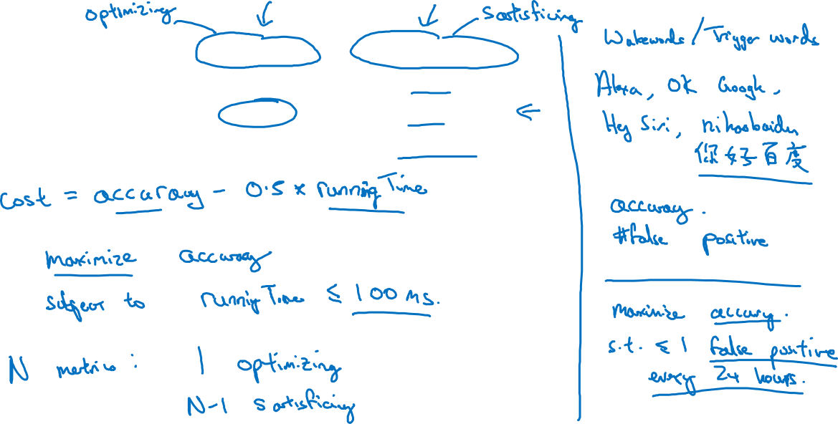
Another cat classification example
Classifier | Accuracy | Running time
A | 90% | 80ms
B | 92% | 95ms
C | 95% | 1,500ms

Slide 13
Satisficing and optimizing metric(Supplemental Notes)
There are different metrics to evaluate the performance of a classifier, they are called evaluation matrices. They can be categorized as satisficing and optimizing matrices. It is important to note that these evaluation matrices must be evaluated on a training set, a development set or on the test set.
…
See more in Supplemental Notes.

Slide 14
Setting up your goal
Train/dev/test
distributions
deeplearning.ai

Slide 15
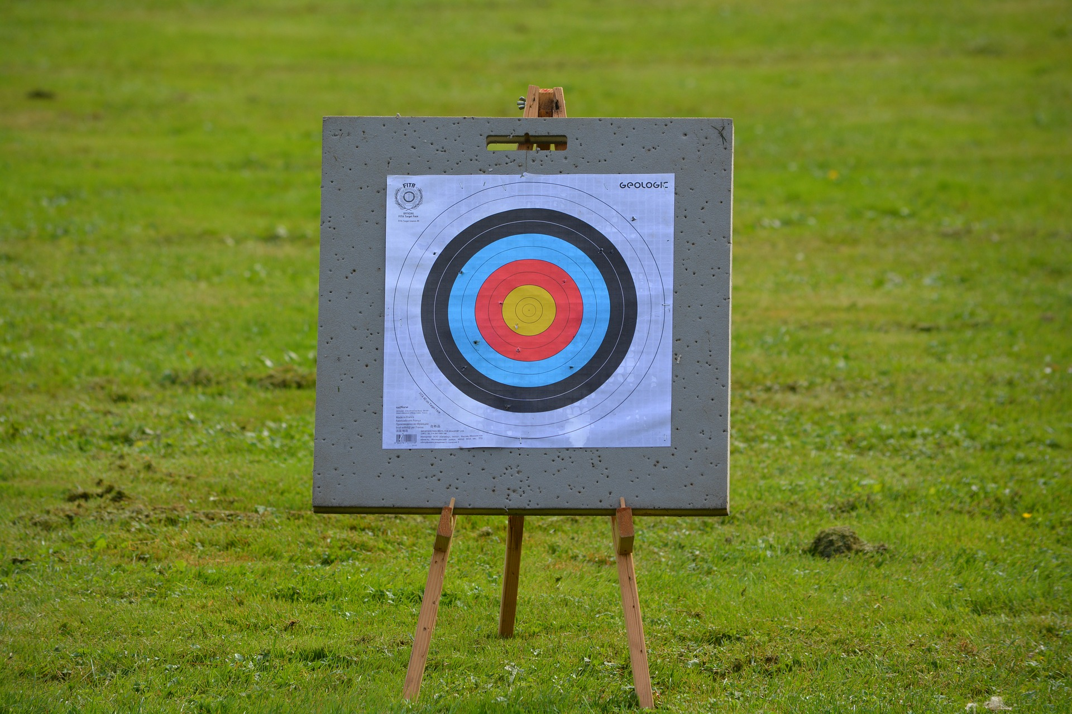
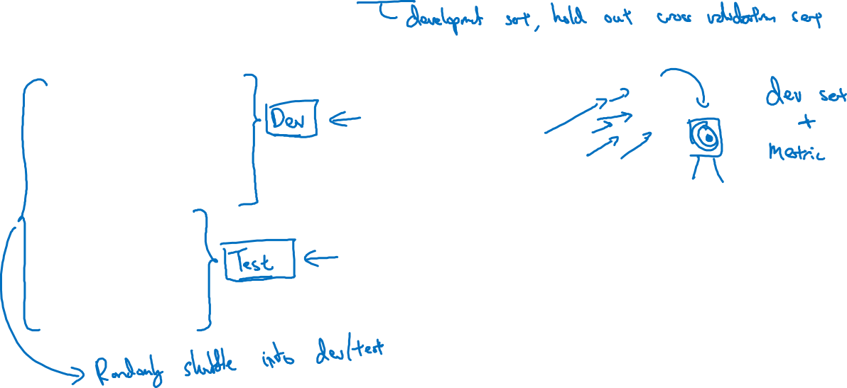
Cat classification dev/test sets
Regions:
US
UK
Other Europe
South America
India
China
Other Asia
Australia
Idea
Experiment
Code

Slide 16
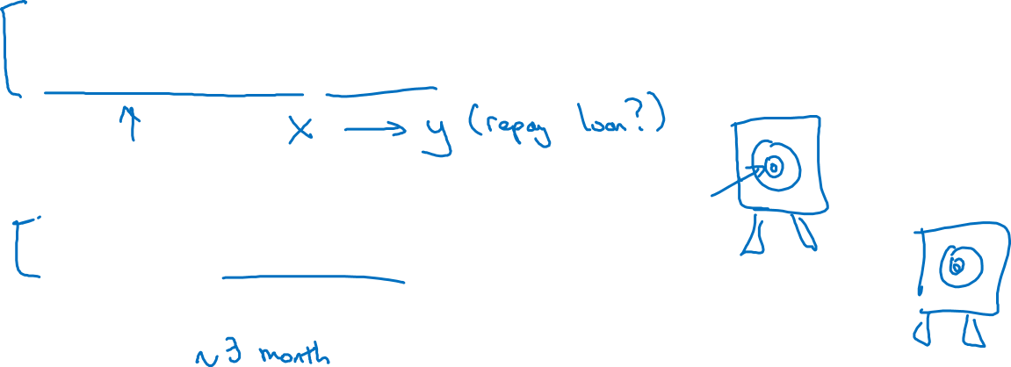
True story (details changed)
Optimizing on dev set on loan approvals for medium income zip codes
Tested on low income zip codes

Slide 17
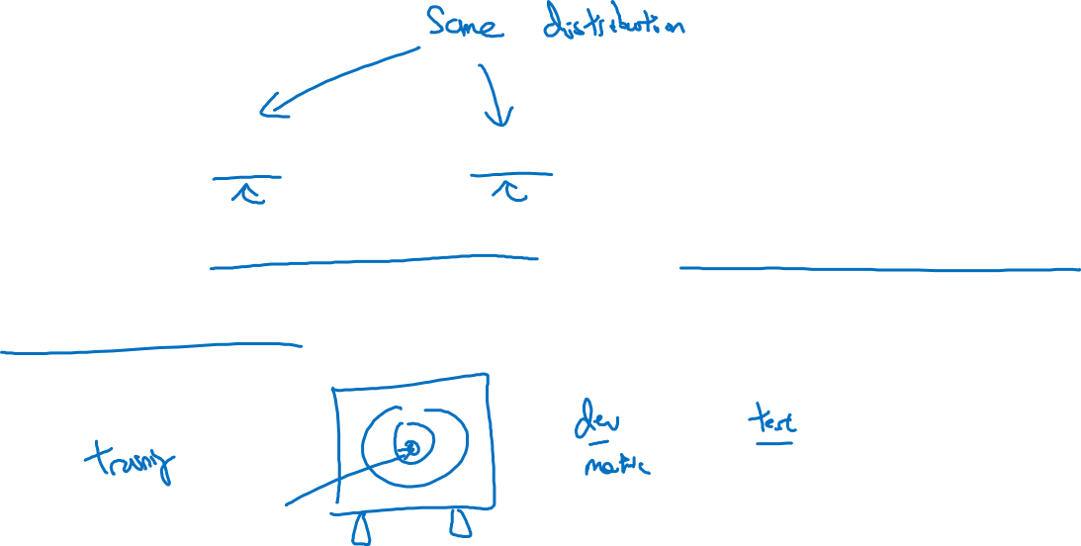
Guideline
Choose a dev set and test set to reflect data you
expect to get in the future and consider important
to do well on.

Slide 18
Training, development and test distributions (Supplemental Notes)
Setting up the training, development and test sets have a huge impact on productivity. It is important to choose the development and test sets from the same distribution and it must be taken randomly from all the data.
Guideline
Choose a development set and test set to reflect data you expect to get in the future and consider important to do well.

Slide 19
Setting up your goal
Size of dev
and test sets
deeplearning.ai

Slide 20
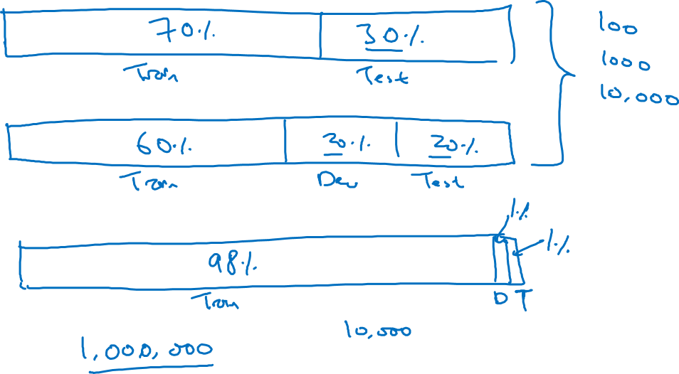
Old way of splitting data

Slide 21
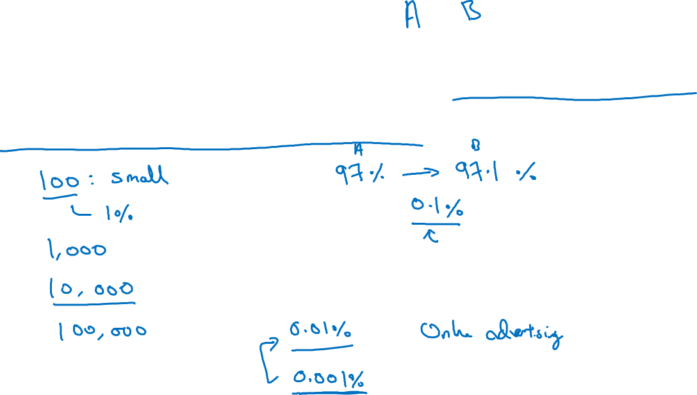
Size of dev set
Set your dev set to be big enough to detect differences in
algorithm/models you’re trying out.

Slide 22
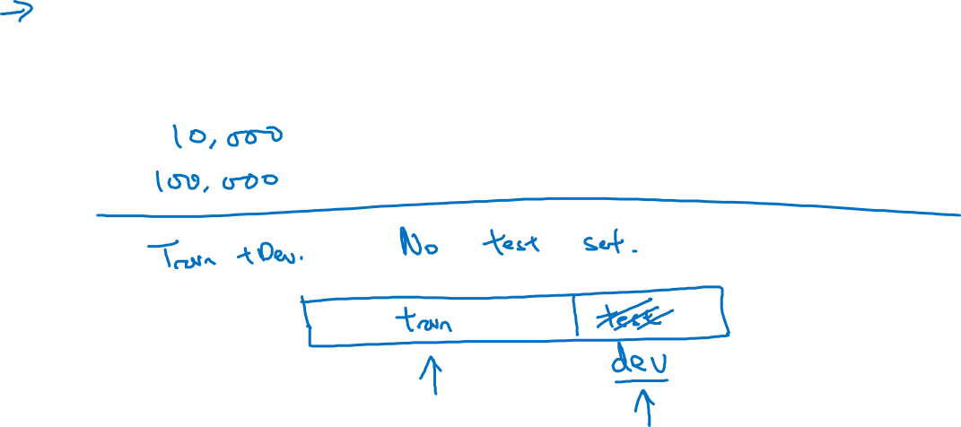
Size of test set
Set your test set to be big enough to give high confidence
in the overall performance of your system.

Slide 23
Size of the development and test sets (Supplemental Notes)
…
Guidelines
Set up the size of the test set to give a high confidence in the overall performance of the system.
Test set helps evaluate the performance of the final classifier which could be less 30% of the whole data set.
The development set has to be big enough to evaluate different ideas.
See more in Supplemental Notes.

Slide 24
Setting up your goal
When to change
dev/test sets and
metrics
deeplearning.ai

Slide 25
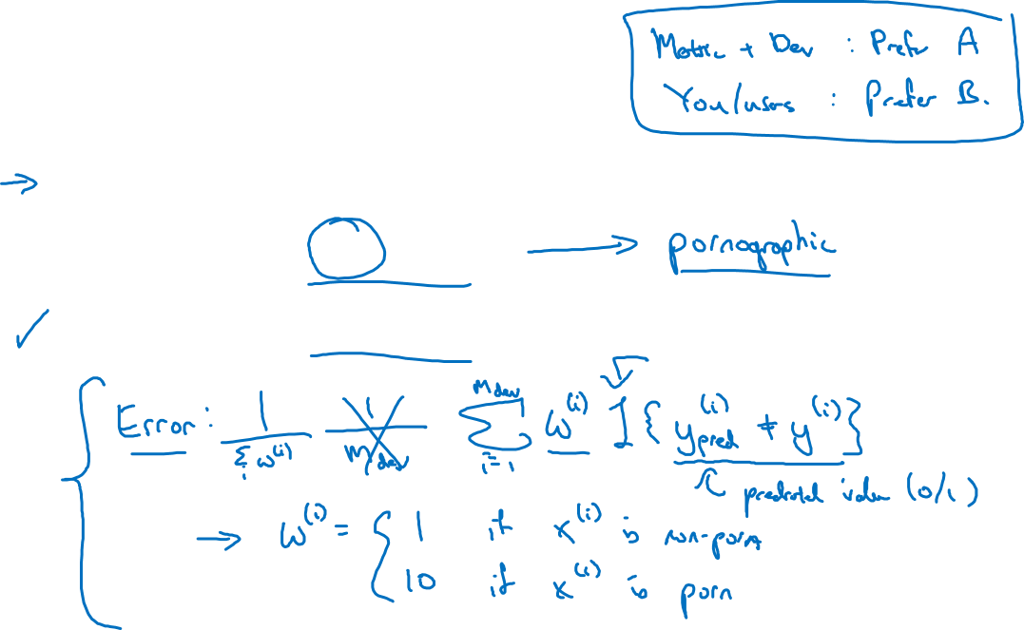
Cat dataset examples
Metric: classification error
Algorithm A: 3% error
Algorithm B: 5% error

Slide 26
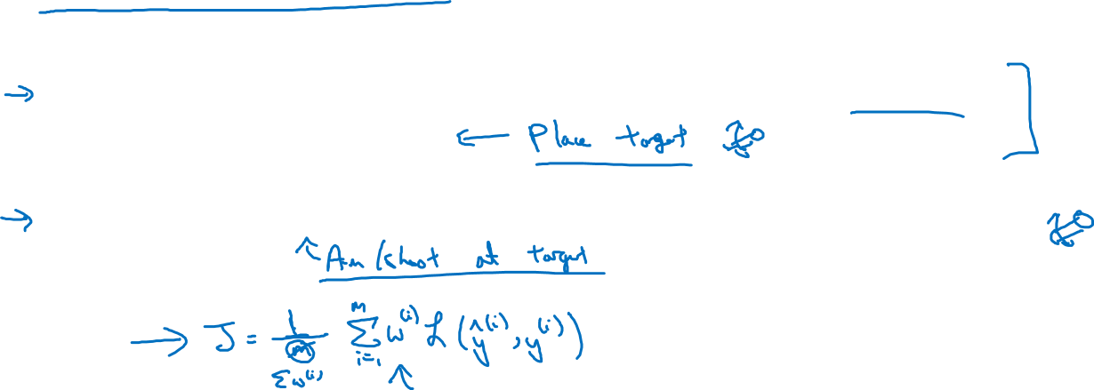
Orthogonalization for cat pictures: anti-porn
So far we’ve only discussed how to define a metric to evaluate classifiers.
2. Worry separately about how to do well on this metric.

Slide 27
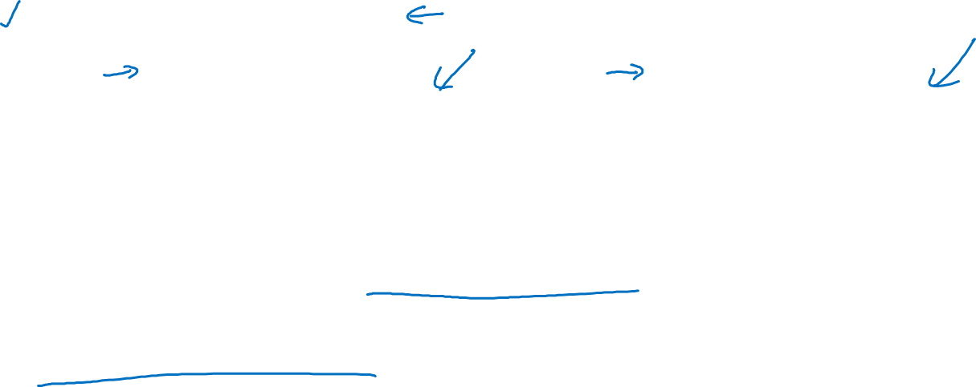
Another example
Algorithm A: 3% error
Algorithm B: 5% error
Dev/test
User images
If doing well on your metric + dev/test set does not
correspond to doing well on your application, change your
metric and/or dev/test set.

Slide 28
When to change development/test sets and metrics (Supplemental Notes)
…
Guideline
1. Define correctly an evaluation metric that helps better rank order classifiers
2. Optimize the evaluation metric
See more in Supplemental Notes.

Slide 29
Comparing to human-level performance
Why human-level
performance?
deeplearning.ai

Slide 30
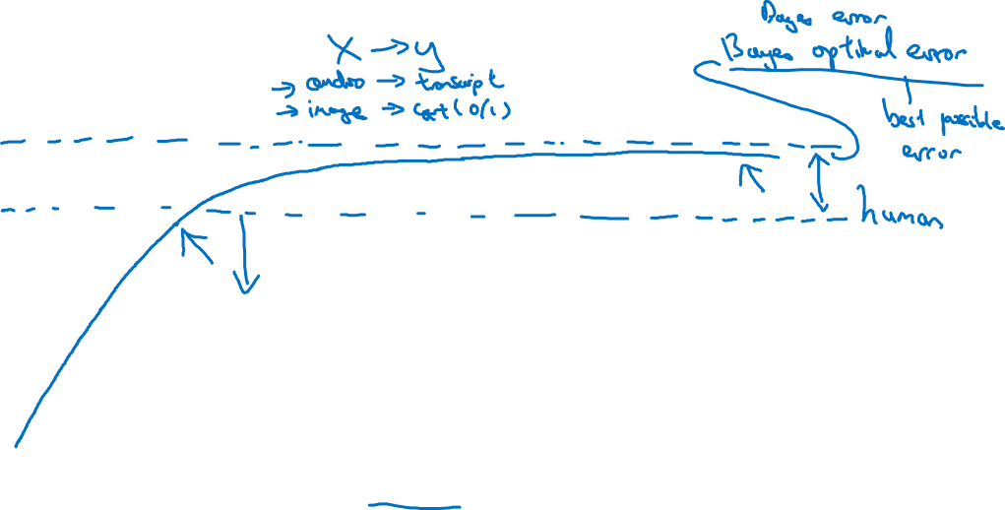
Comparing to human-level performance
accuracy
time

Slide 31
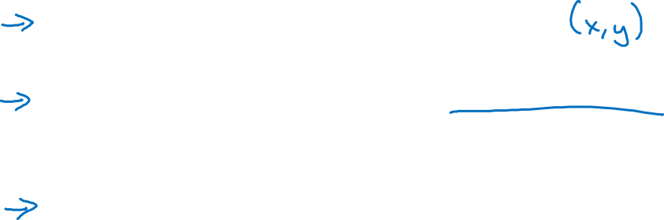
Why compare to human-level performance
Humans are quite good at a lot of tasks. So long as ML is worse than humans, you can:
Get labeled data from humans.
Gain insight from manual error analysis: Why did a person get this right?
Better analysis of bias/variance.

Slide 32
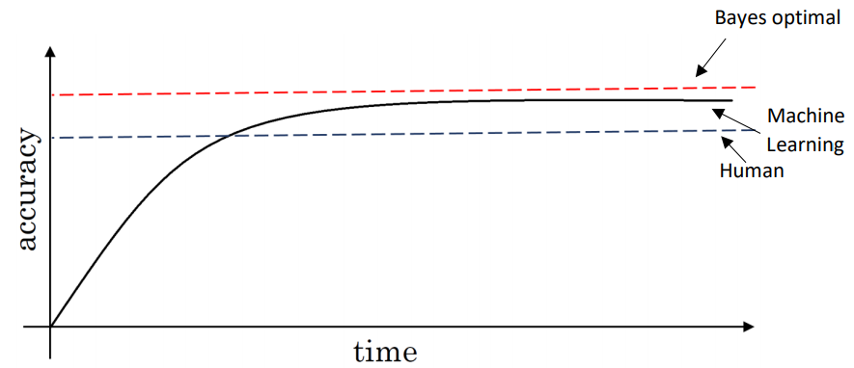
Why human-level performance? (Supplemental Notes)
…
- Get labeled data from humans
- Gain insight from manual error analysis: Why did a person get this right?
- Better analysis of bias/variance.
…
See more in Supplemental Notes.

Slide 33
Comparing to human-level performance
Avoidable bias
deeplearning.ai

Slide 34
Bias and Variance
high bias
“just right”
high variance

Slide 35
Bias and Variance
Cat classification
Training set error: 1% 15% 15% 0.5%
Dev set error: 11% 16% 30% 1%

Slide 36
Cat classification example
Training error 8%
8 %
Dev error 10%
10 %

Slide 37
Avoidable bias(Supplemental Notes)
By knowing what the human-level performance is, it is possible to tell when a training set is performing well or not.
…
See more in Supplemental Notes.

Slide 38
Comparing to human-level performance
Understanding human-level performance
deeplearning.ai

Slide 39
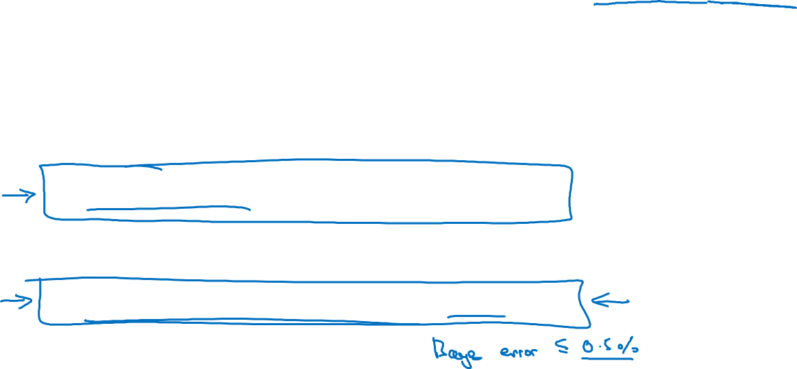

Human-level error as a proxy for Bayes error
Medical image classification example:
Suppose:
(a) Typical human ………………. 3 % error
(b) Typical doctor ………………... 1 % error
(c) Experienced doctor …………... 0.7 % error
(d) Team of experienced doctors .. 0.5 % error
What is “human-level” error?

Slide 40
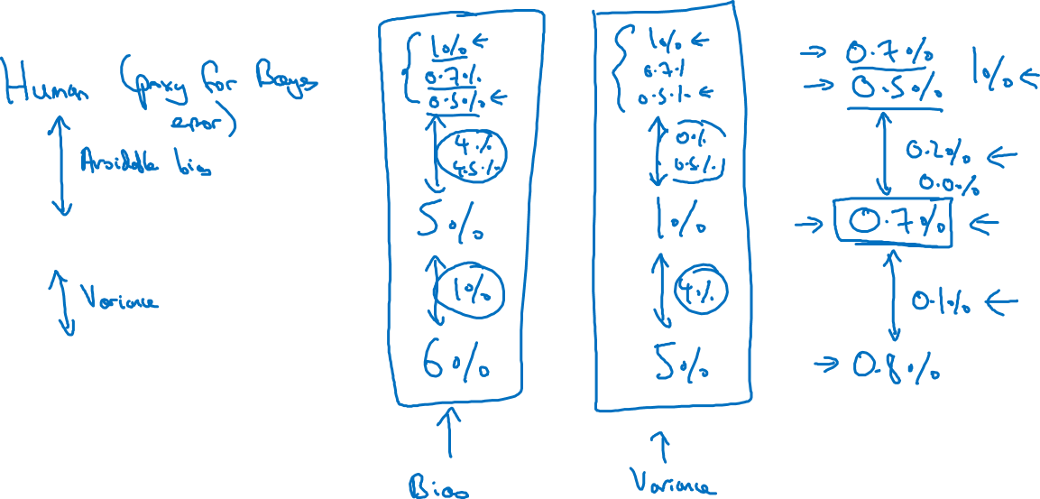
Error analysis example
Training error
Dev error

Slide 41
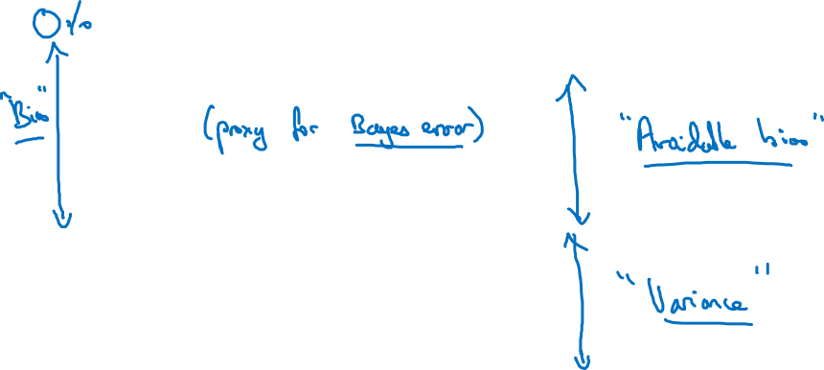
Summary of bias/variance with human-level performance
Human-level error
Training error
Dev error

Slide 42
Understanding human-level performance(Supplemental Notes)
Human-level error gives an estimate of Bayes error.
…
Summary of bias/variance with human-level performance
Human - level error – proxy for Bayes error
If the difference between human-level error and the training error is bigger than the difference between the training error and the development error. The focus should be on bias reduction technique
If the difference between training error and the development error is bigger than the difference between the human-level error and the training error. The focus should be on variance reduction technique
See more in Supplemental Notes.

Slide 43
Comparing to human-level performance
Surpassing human- level performance
deeplearning.ai

Slide 44
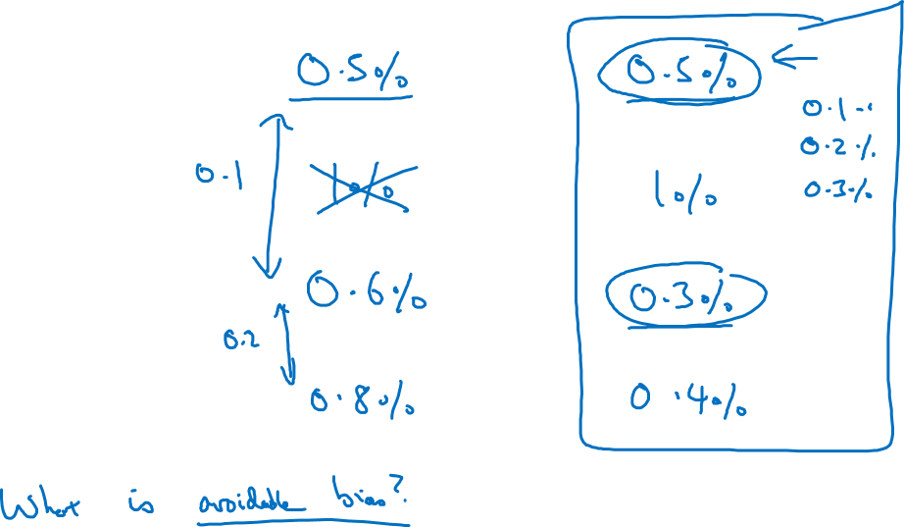
Surpassing human-level performance
Team of humans
One human
Training error
Dev error

Slide 45
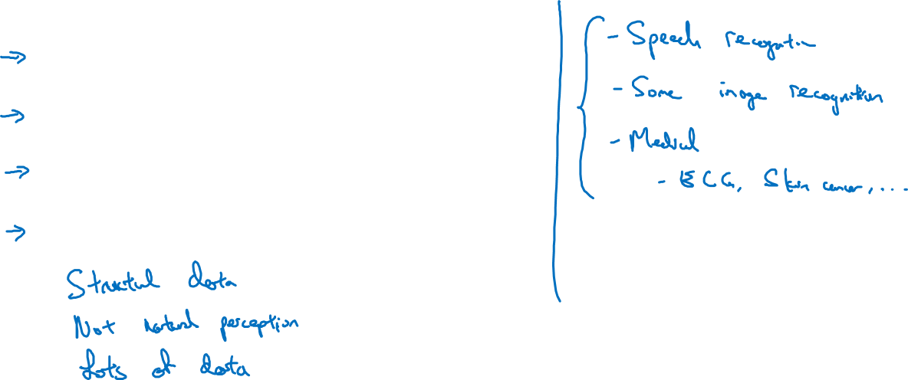
Problems where ML significantly surpasses human-level performance
Online advertising
Product recommendations
Logistics (predicting transit time)
Loan approvals

Slide 46
Surpassing human-level performance (Supplemental Notes)
…
There are many problems where machine learning significantly surpasses human-level performance, especially with structured data:
Online advertising
Product recommendations
Logistics (predicting transit time)
Loan approvals
See more in Supplemental Notes.

Slide 47
Comparing to human-level performance
Improving your model
performance
deeplearning.ai

Slide 48
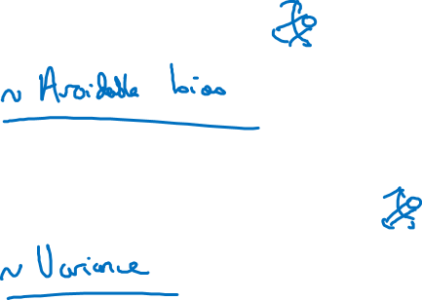
The two fundamental assumptions of supervised learning
1. You can fit the training set pretty well.
2. The training set performance generalizes pretty
well to the dev/test set.

Slide 49
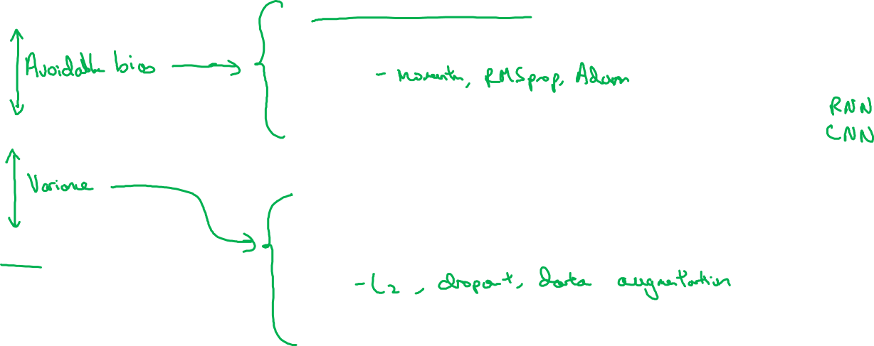
Reducing (avoidable) bias and variance
Human-level
Train bigger model
Train longer/better optimization algorithms
Training error
NN architecture/hyperparameters search
More data
Dev error
Regularization
NN architecture/hyperparameters search

Slide 50
Improving your model performance (Supplemental Notes)
There are 2 fundamental assumptions of supervised learning. The first one is to have a low avoidable bias which means that the training set fits well. The second one is to have a low or acceptable variance which means that the training set performance generalizes well to the development set and test set.
If the difference between human-level error and the training error is bigger than the difference between the training error and the development error, the focus should be on bias reduction technique which are training a bigger model, training longer or change the neural networks architecture or try various hyperparameters search.
If the difference between training error and the development error is bigger than the difference between the human-level error and the training error, the focus should be on variance reduction technique which are bigger data set, regularization or change the neural networks architecture or try various hyperparameters search.
…
See more in Supplemental Notes.

